Slide 1
Iteration #5
Tech Lithe Creations

Slide 2
Agenda
Introduction
Entity Relational Diagram
Data Dictionary
Prototypes
Conclusion

Slide 3
DATABASE DESIGN
We’ve created a prototype database for the KHBPA using Microsoft Access
The database contains data of vital information involving your company, your employees, members, and any other areas you would like to collect data from.
The following ERD helps display the relationships of each table in the database so that you can connect and see how each table connects.

Slide 4
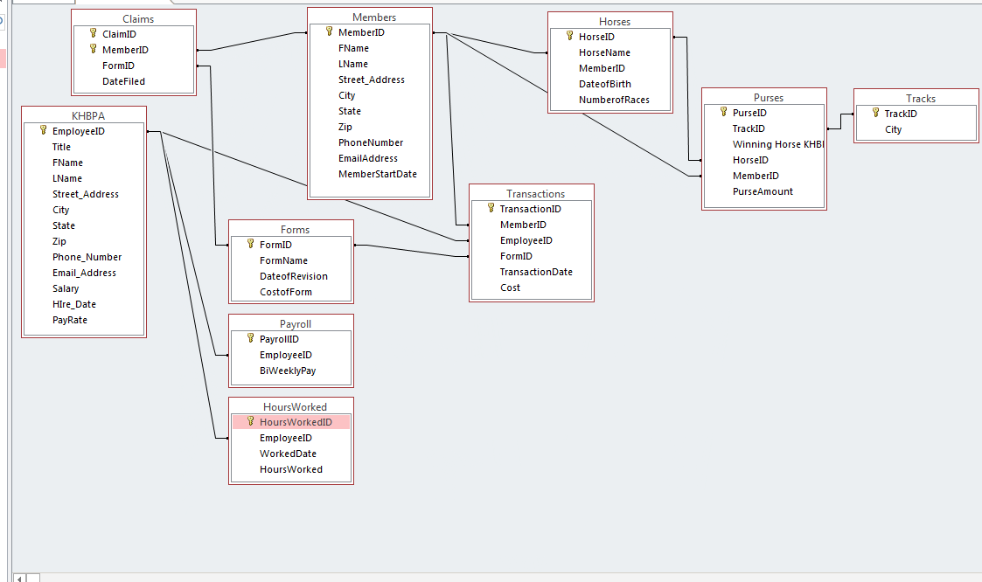
Notes:
Savanah

Slide 5
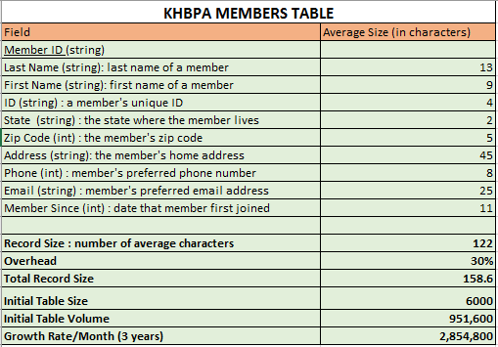
DATABASE DICTIONARY

Slide 6
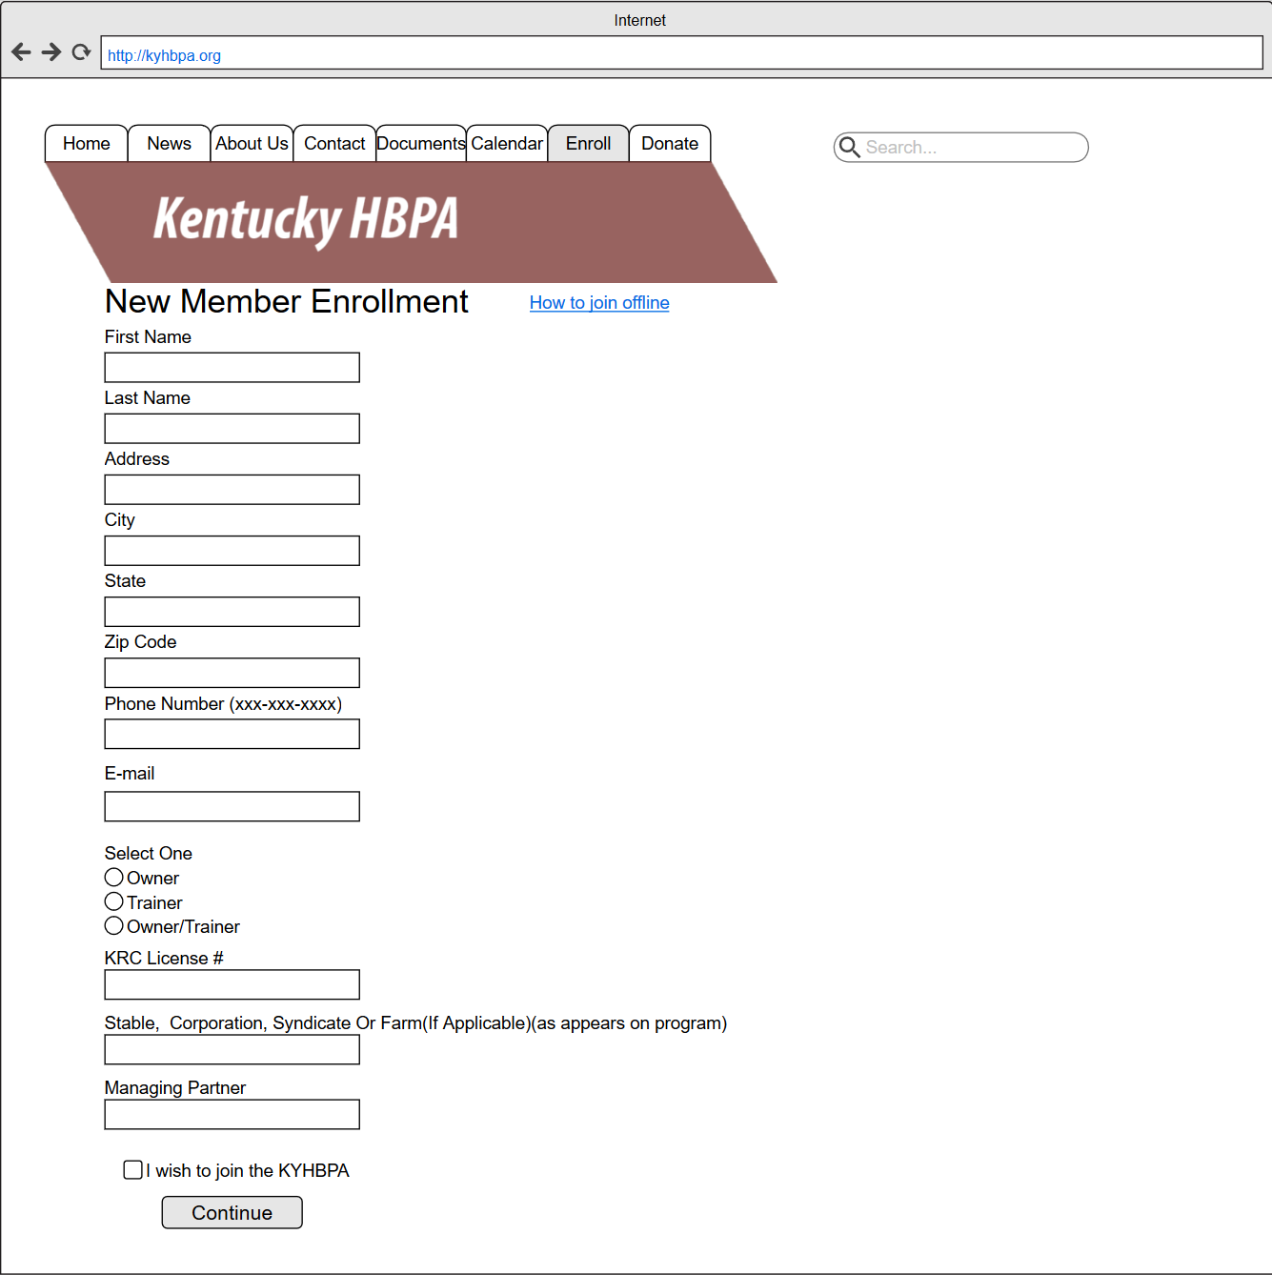
Prototypes
Enrollment

Slide 7
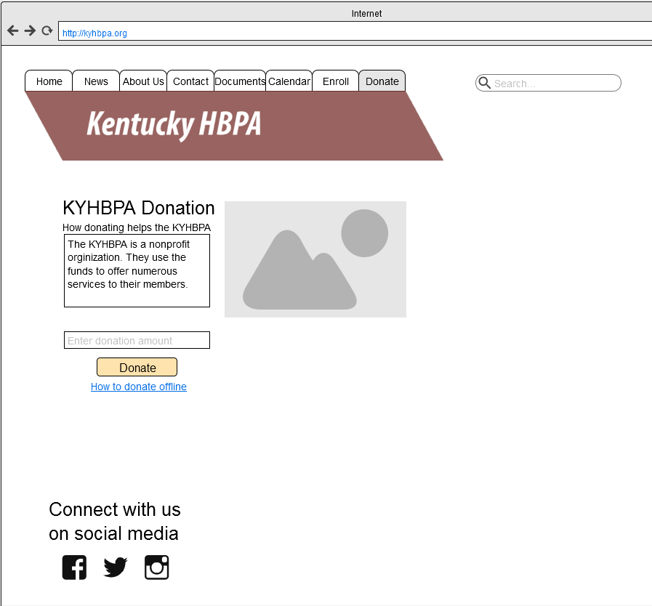
Prototypes
Donations

Slide 8
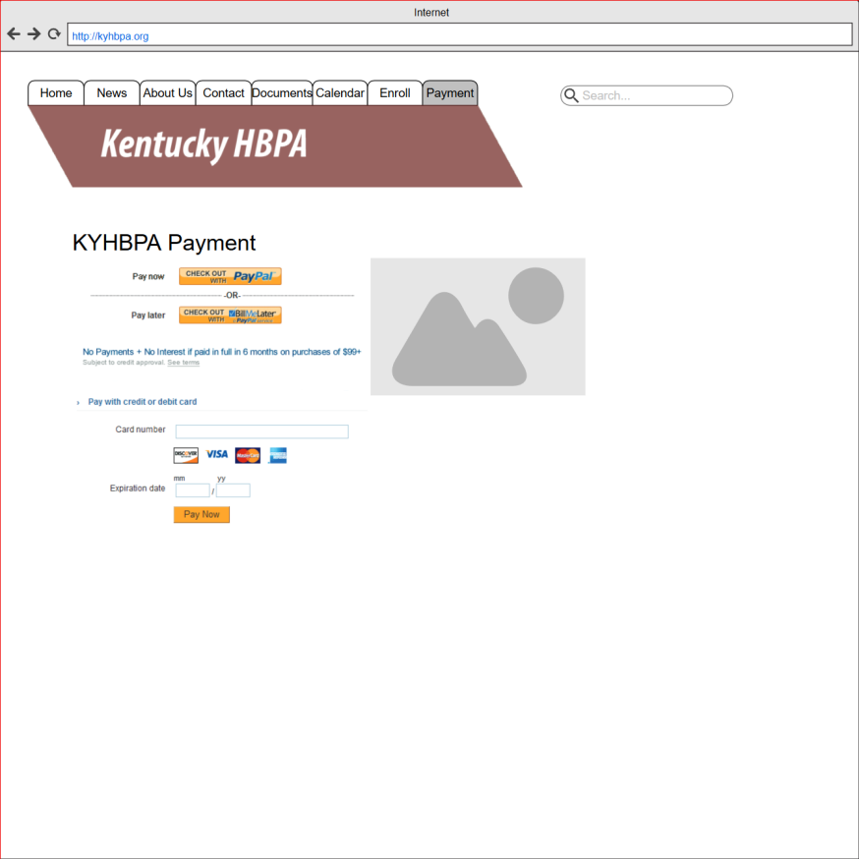
Prototypes
Payment

Slide 9
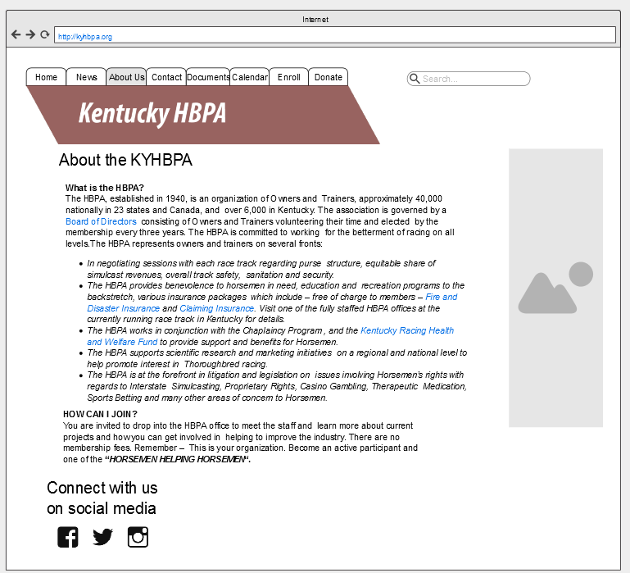
Prototypes
About Us

Slide 10
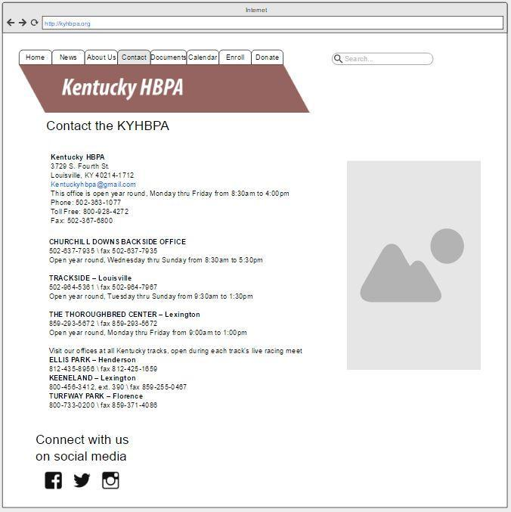
Prototypes
Contact Us

Slide 11
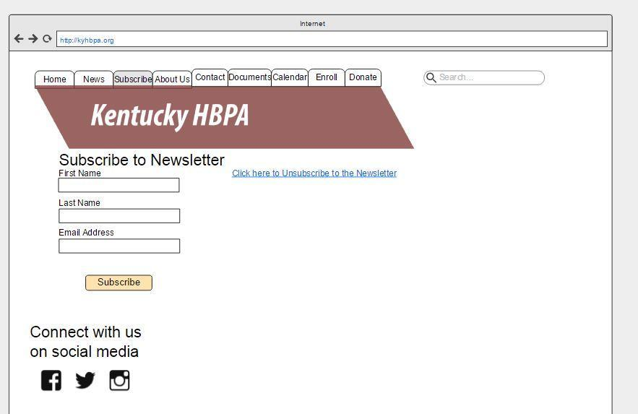
Prototypes
Subscribe

Slide 12
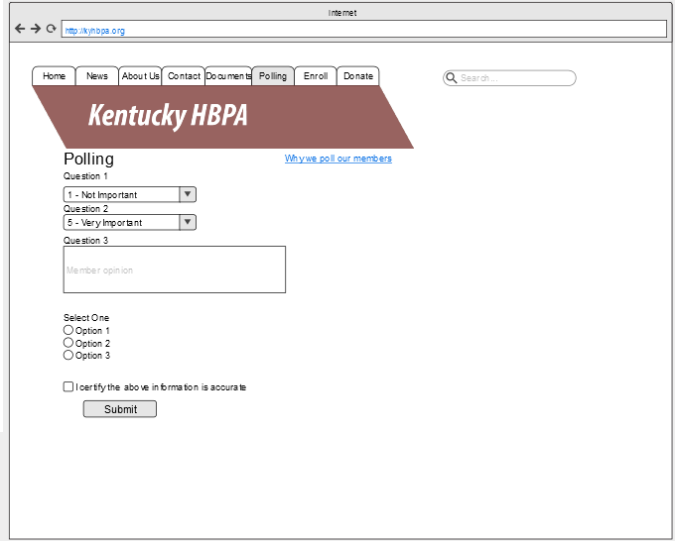
Prototypes
Polling

Slide 13
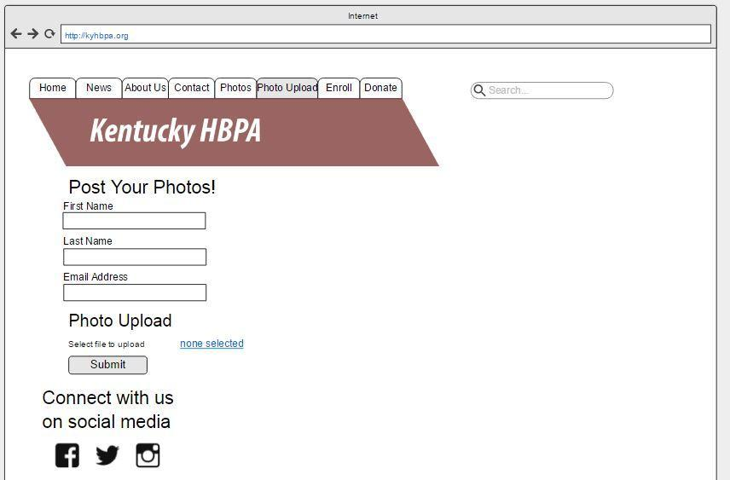
Prototypes
Post photos

Slide 14
Agenda
Introduction
Entity Relational Diagram
Data Dictionary
Prototypes
Conclusion
Questions

Slide 15
Questions?

